Slide 1
Air Quality, Chemical release, Income, and Racial Analysis in Minneapolis
Maochuan Wang

Slide 2
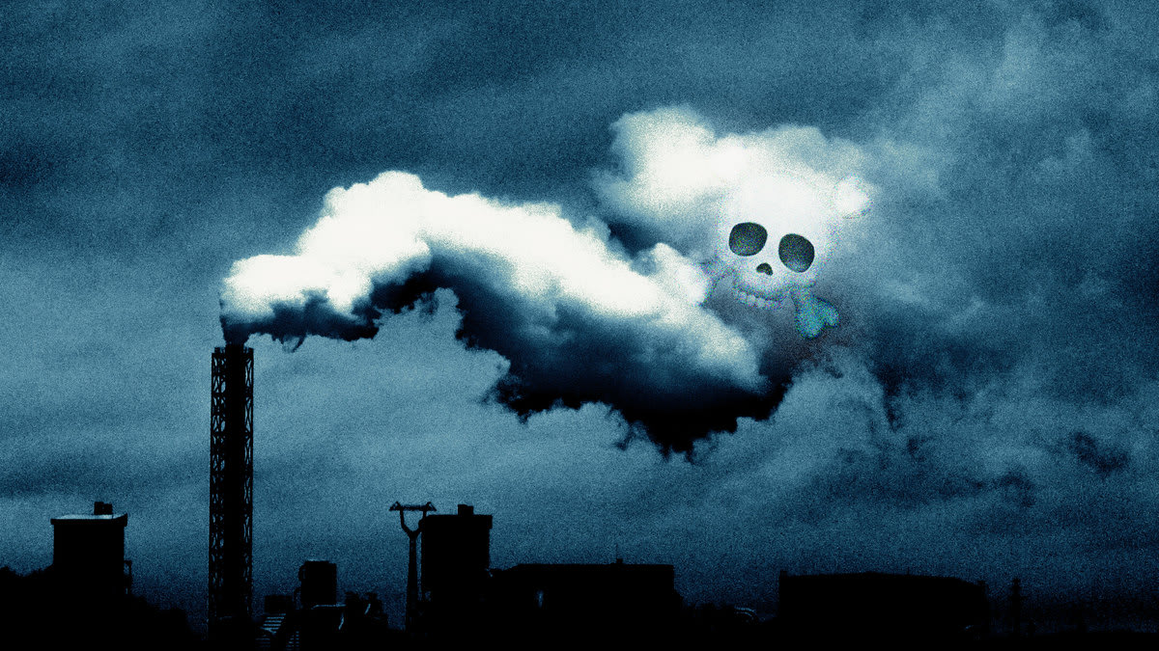
Introduction
Purpose: Analyze the relationships between toxic chemicals, income, and racial demographics in Minneapolis using geospatial SQL queries.
Main goals of the project:
Investigate the presence of toxic chemicals in the air around Minneapolis
Examine the distribution of income and racial demographics in the city
Identify potential correlations between air quality, chemical release, income, and racial demographics

Slide 3
Data
Data Used:
Median income and Population by census block group from NHGIS 2019-2020
Toxic Release Inventory 2021
Minneapolis City Boundary
Minneapolis Air Quality Survey
Import Process:
Shapefiles: Use shp2pgsql tool to upload to postgis database
CSV Files: Create table statement to import CSV data into the database
Data Cleaning Steps:
Handle missing values or errors:
Remove unnecessary columns, correct errors
Normalize data types and units:
Ensure consistent data types and units across datasets

Slide 4
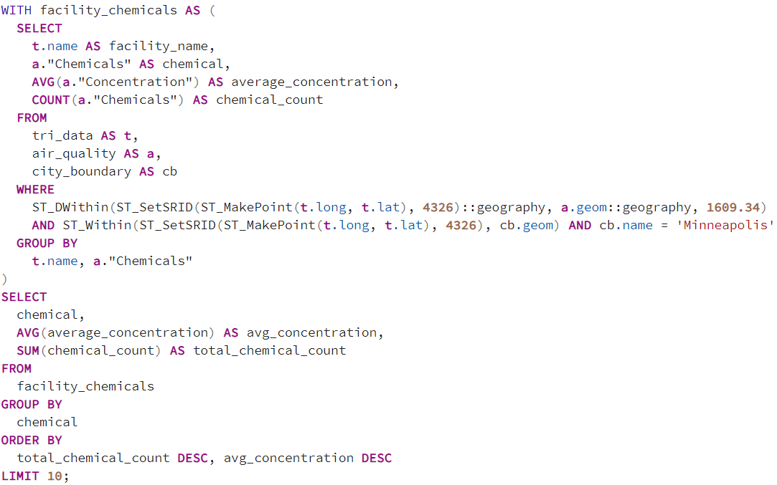
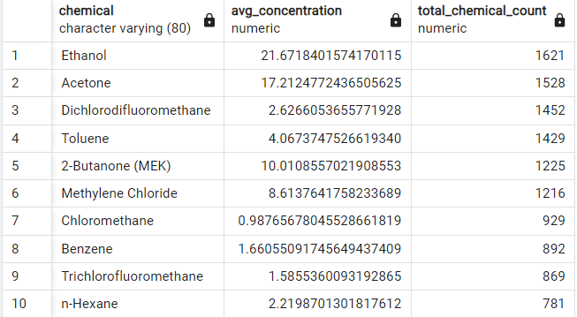
SQL
Top 10 most common chemicals in the air along with their average concentration in ug/m3 within 1-mile radius of an Toxic Release facility.

Slide 5
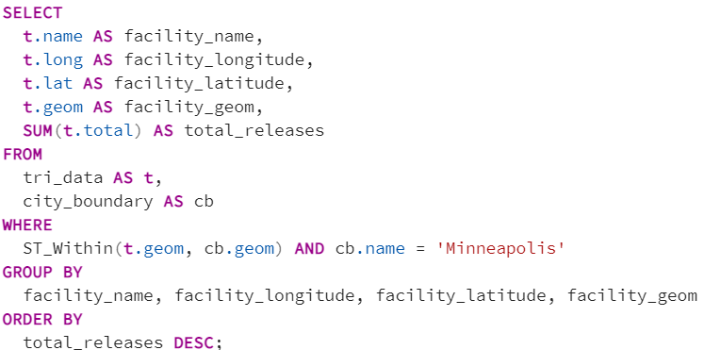
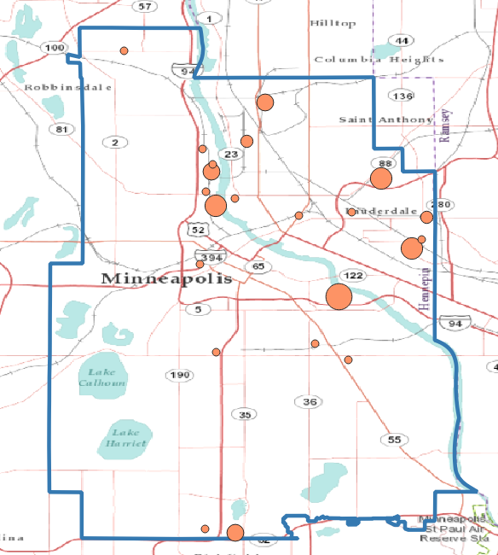
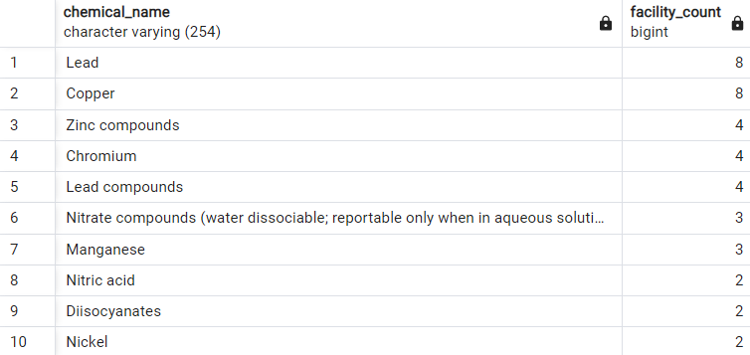
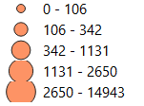
SQL
Total Chemical Release in pounds per facility in Minneapolis
Pounds

Slide 6
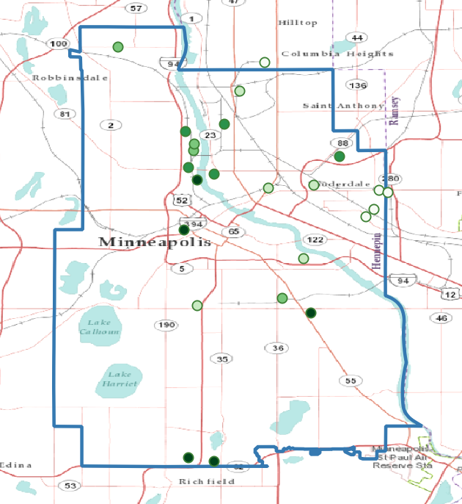
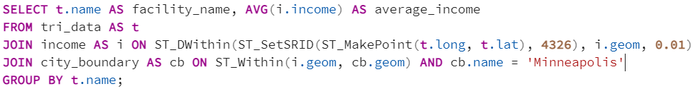
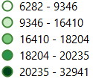
SQL
Calculate the median household income within “1 km” buffer of each facility in the Toxic Release Inventory table.
Median income in USD

Slide 7
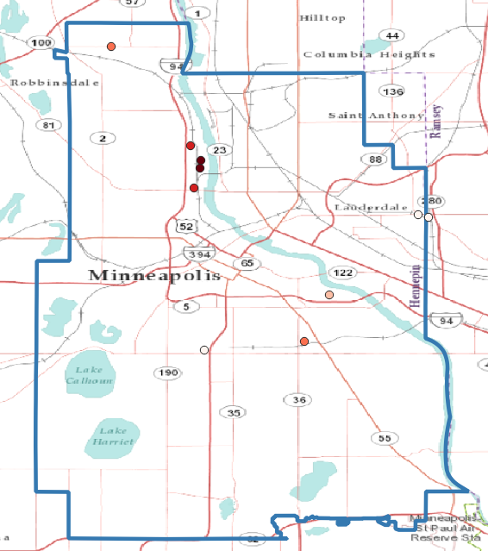
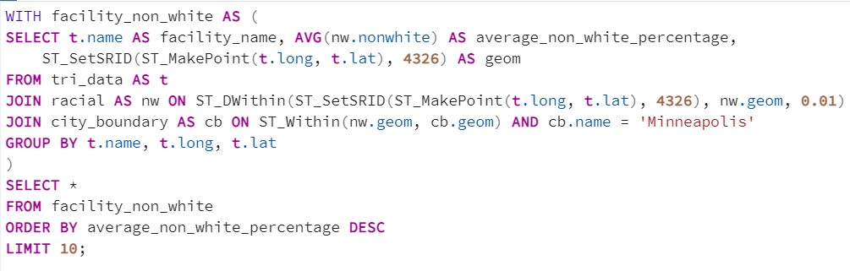
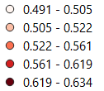
SQL
Top 10 facilities with the highest average non-white percentage within a 1 km buffer:
Percentage of non-white

Slide 8
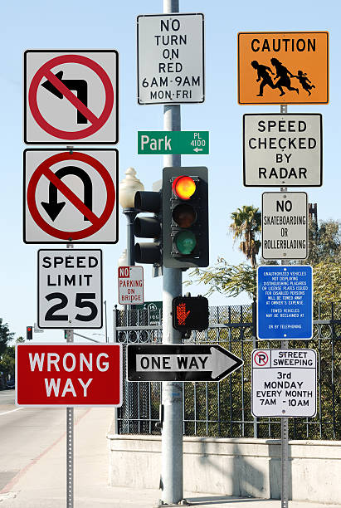
Limitation
Data quality: Inaccuracies, missing data, or inconsistencies in the datasets could affect the outcomes of the study.
Temporal limitations: The results may not reflect the current situation or future trends in air quality and its impact on communities.
Spatial resolution: The block group level analysis may not capture finer-scale variations in air quality and demographics.
Correlation vs. causation: The project identified correlations, but further research is needed to establish causal relationships and account for other potential factors.

Slide 9

Conclusion
Integrating multiple datasets revealed the spatial distribution of toxic facilities and their potential impact on nearby communities.
Results highlight environmental justice concerns within the city of Minneapolis, where low-income and high-minority neighborhoods are disproportionately affected by toxic release facilities.
Stakeholders, such as local governments and community organizations, should consider these findings when developing policies and initiatives aimed at reducing pollution and promoting equity.

